Slide 1
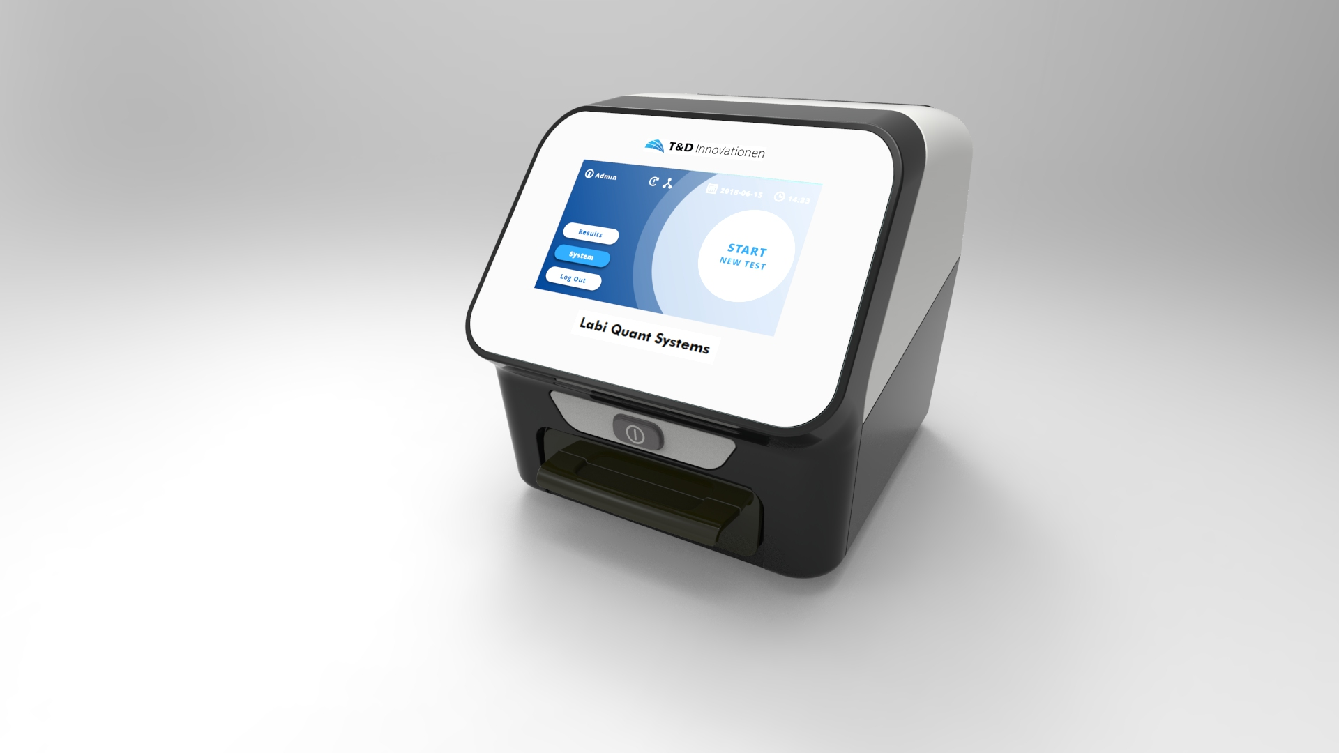
Project Proposal and deliverables
11-Dec-2019
C. Fischer-Rasokat

Slide 2
Instrument Design
Labi Quant Systems
Front View
Labi Quant Systems
Front View with open drawer
Labi Quant Systems
Rear View

Slide 3
LQS: Perfect fit for reflective lateral flow test and color change tests
5 Mpix. black/white camera (8 Bit)
Multi color illumination to recognize color change tests
Optimized Software for Lateral Flow tests
Calibration and Self-adjustment among internal reference material
High Performance CPU for quick response
QC material for external routine checks
Low Inter device variation < 3% CV
High reproducibility between different readings < 0.5% CV
Dot detection (300µm diameter)

Slide 4
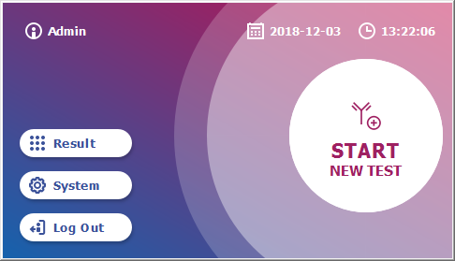
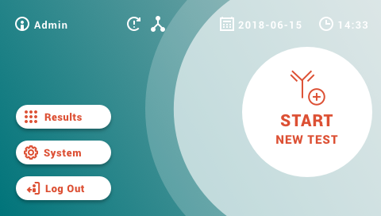
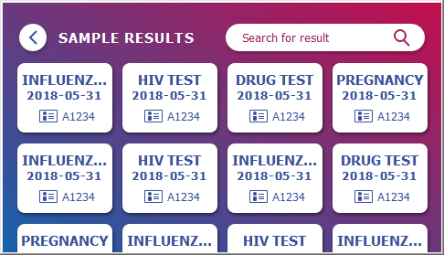
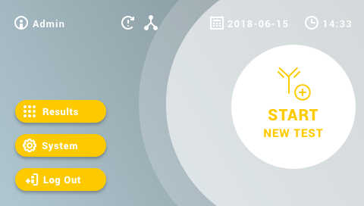
LQS: Perfect fit for reflective lateral flow test and color change tests
4,3´´ touch display
Intuitive workflow with few user interactions
Fully barcode supported test and patient ID entry
User centric design among DIN EN ISO 9241-210
Many customization options

Slide 5
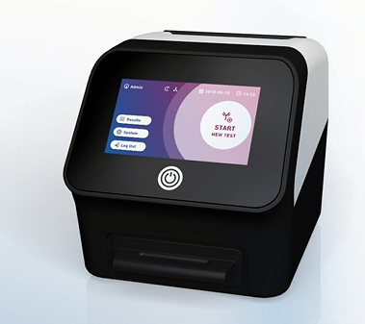
Consequent focus on Barcode Input
Method file on barcode card:
Measurement parameter
Evaluation parameter
Calibration values
Reader:
Imports method file via separate menu

Slide 6
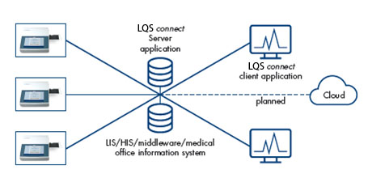
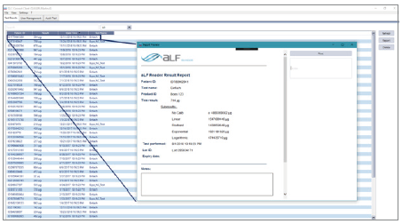
LQS: Perfect fit for reflective lateral flow test and color change tests
Internal/External Barcodereader
Read method file via 2D Barcode
Read Patient ID via external1D/2D Barcode
USB ports
Plug and play printer and barcode reader
Export Raw Data files on USB stick
Ethernet
Connection to LQS connect SW
LQS connect as local data management system or
LQS connect as adapter to LIS,KIS, middleware or physician office management software
HL7 and other communication protocols feasible

